Slide 1
Coding Best Practices
For writing tests that will improve the quality of code in your organization

Slide 2
About me:
I’ve been working 15 years as a software developer, 14 of those in .NET
For two and a half of these years I worked in France
I’ve worked for Loto-Quebec, Hydro-Quebec, CGI, TekSystems (the Keystone XL project), Credit Agricole and more.
Currently doing a Master’s degree in Software Engineering, with a project in the field of AI.

Slide 3
What this presentation isn’t meant to be:
A lecture;
A gospel of software engineering;
The Ultimate Answer.

Slide 4
What it is meant to be:
A chance to exchange ideas;
An open discussion between professionals;
A chance for you to participate.

Slide 5
Why should you write unit tests?
Not just because your boss told you so;
Not to prove your algorithm is working (although it might do that);
Not just because you wrote code - not all code is worth unit testing and time is a limited resource (rule of the 80/20);
They are not functional / integration tests, and they are NOT a silver bullet.

Slide 6
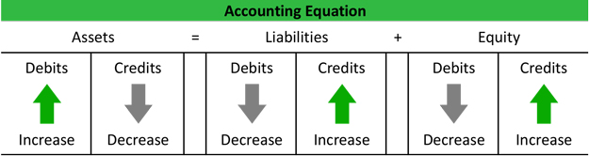
Unit tests are meant to test ONE public method in ONE public class.
The goal is to:
Force you to rethink the structural design of your method;
Help you identify flaws, dependencies and less-than ideal aspects of the code;
Provide a safety net for future changes.
UNIT TESTS ARE THE SOFTWARE
EQUIVALENT OF DOUBLE-ENTRY
ACCOUNTING

Slide 7
Enemies of unit tests
Poor understanding by managers / developers;
Short delivery times;
A willingness to forgo them when there’s a crunch.

Slide 8
Friends of unit tests
Practice and thoroughness;
A desire to produce quality code;
An understanding of the consequences of not writing them.

Slide 9
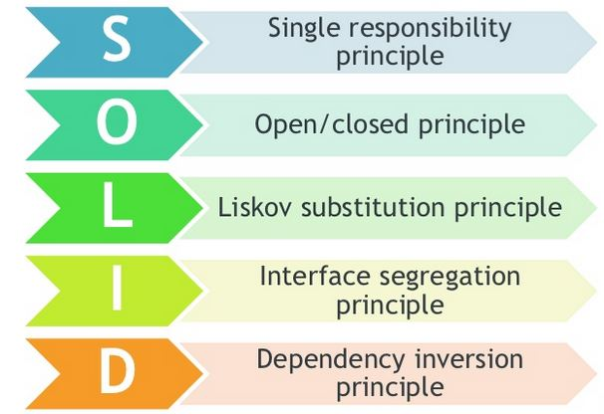
Best Practices
Let’s start with something concrete. Something…

Slide 10
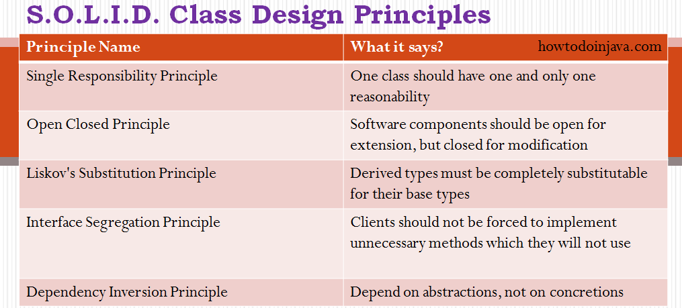

Slide 11
Single Responsibility Principle
A class should do one thing, and do it well.
A method that does only one thing is easier to test.

Slide 12
Dependency Inversion Principle
This is the most important principle when it comes to unit testing.
Dependencies are a sure-fire to way to impend or even prevent your capacity to test a class.
A few frameworks, like Microsoft Fakes, will allow you to overcome this obstacle (with something called Shims, a mock on steroids); however, it’s always better to prevent than to fix a problem.

Slide 13

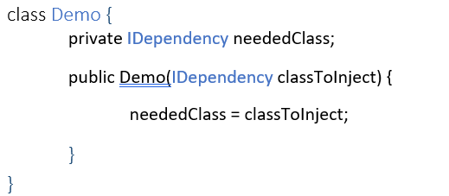
Ways to implement Dependency Injection
The simple way:
Publicly exposed property
Through the constructor:

Slide 14
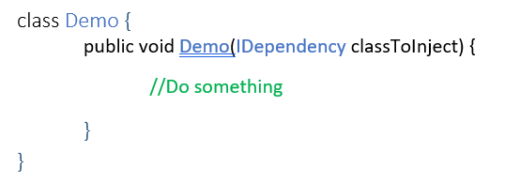
Directly as a method parameter:
These are the simple ways. Although some have a concern that when a method has multiple dependencies it requires the instantiating class to have to much knowledge about the sub-class’ dependencies.
And this is where the complicated way comes in.

Slide 15
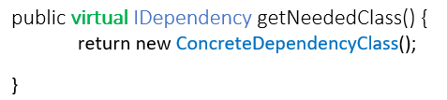
Overridable methods
This will require that you inherit from that class to write your unit tests, and override these methods to return a stub;
It will allow you to isolate your dependencies to the class that needs it;
It does not, however, respect the dependency inversion principle, as your class is still bound to a concretion. You cannot inject another class without changing the code.

Slide 16
Abstract Factory pattern
Alternatively, you can use this pattern to return a concrete instance of the class you need. You would then invoke a method call with a string parameter defining which class you need.
This means that your class still needs to be injected with the interface of the factory so you can replace it, OR use a configuration file that associates the parameter with the actual class and be able to switch that file.
But if you’re going that far you might as well use a…

Slide 17
Service locator
The service locator pattern is basically what most dependency injection frameworks do;
Call the service with a parameter, get the class you need;
Some developers argue it’s inefficient because you need to either:
Create and maintain a config file;
Instantiate and register a list of classes at start-up;
But in large projects with a lot of dependencies it use a viable solution.

Slide 18
Challenge time!
Given an implementation of the Template method pattern and the Strategy pattern, can you tell me where the significant differences will be? (Diagram in the next slide)

Slide 19
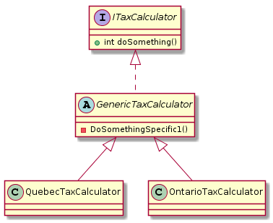
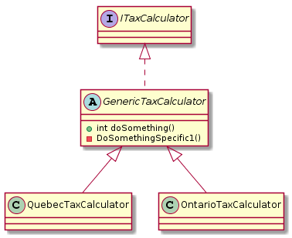
Strategy
Template

Slide 20
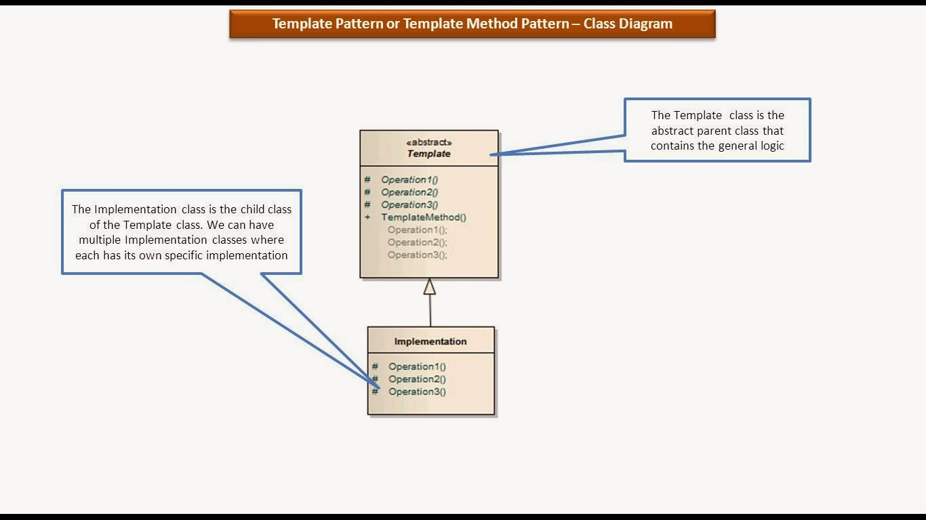
Template Method Pattern

Slide 21
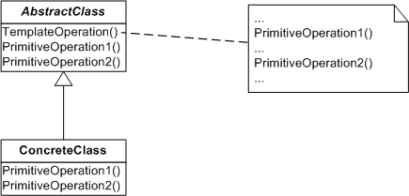
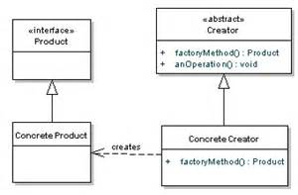
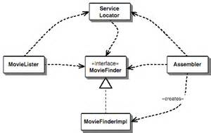
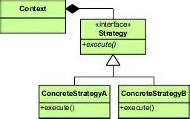
Inversion Of Control Implementations
Template Method is one of the ways to implement an Inversion of Control, along with Service Locator, Dependency Injection, Strategy, and the Factory pattern.

Slide 22
Final word
Best practices are a group of processes and approaches to software engineering and are not simply one or two tricks;
In a world of ever-growing software presence, we are now at a point where we are creating more and more software that can kill. Let’s not forget it.
If you are concerned with software quality, as a developer, know and understand SOLID. As an architect, know and understand GRASP.

Slide 23
Hope you enjoyed this presentation!
Frederic Simard
Frederic.simard@gmail.com

